Slide 1
Scientific Text Analysis
Presentation made by Tadas Laurinaitis IFF-6/8

Slide 2
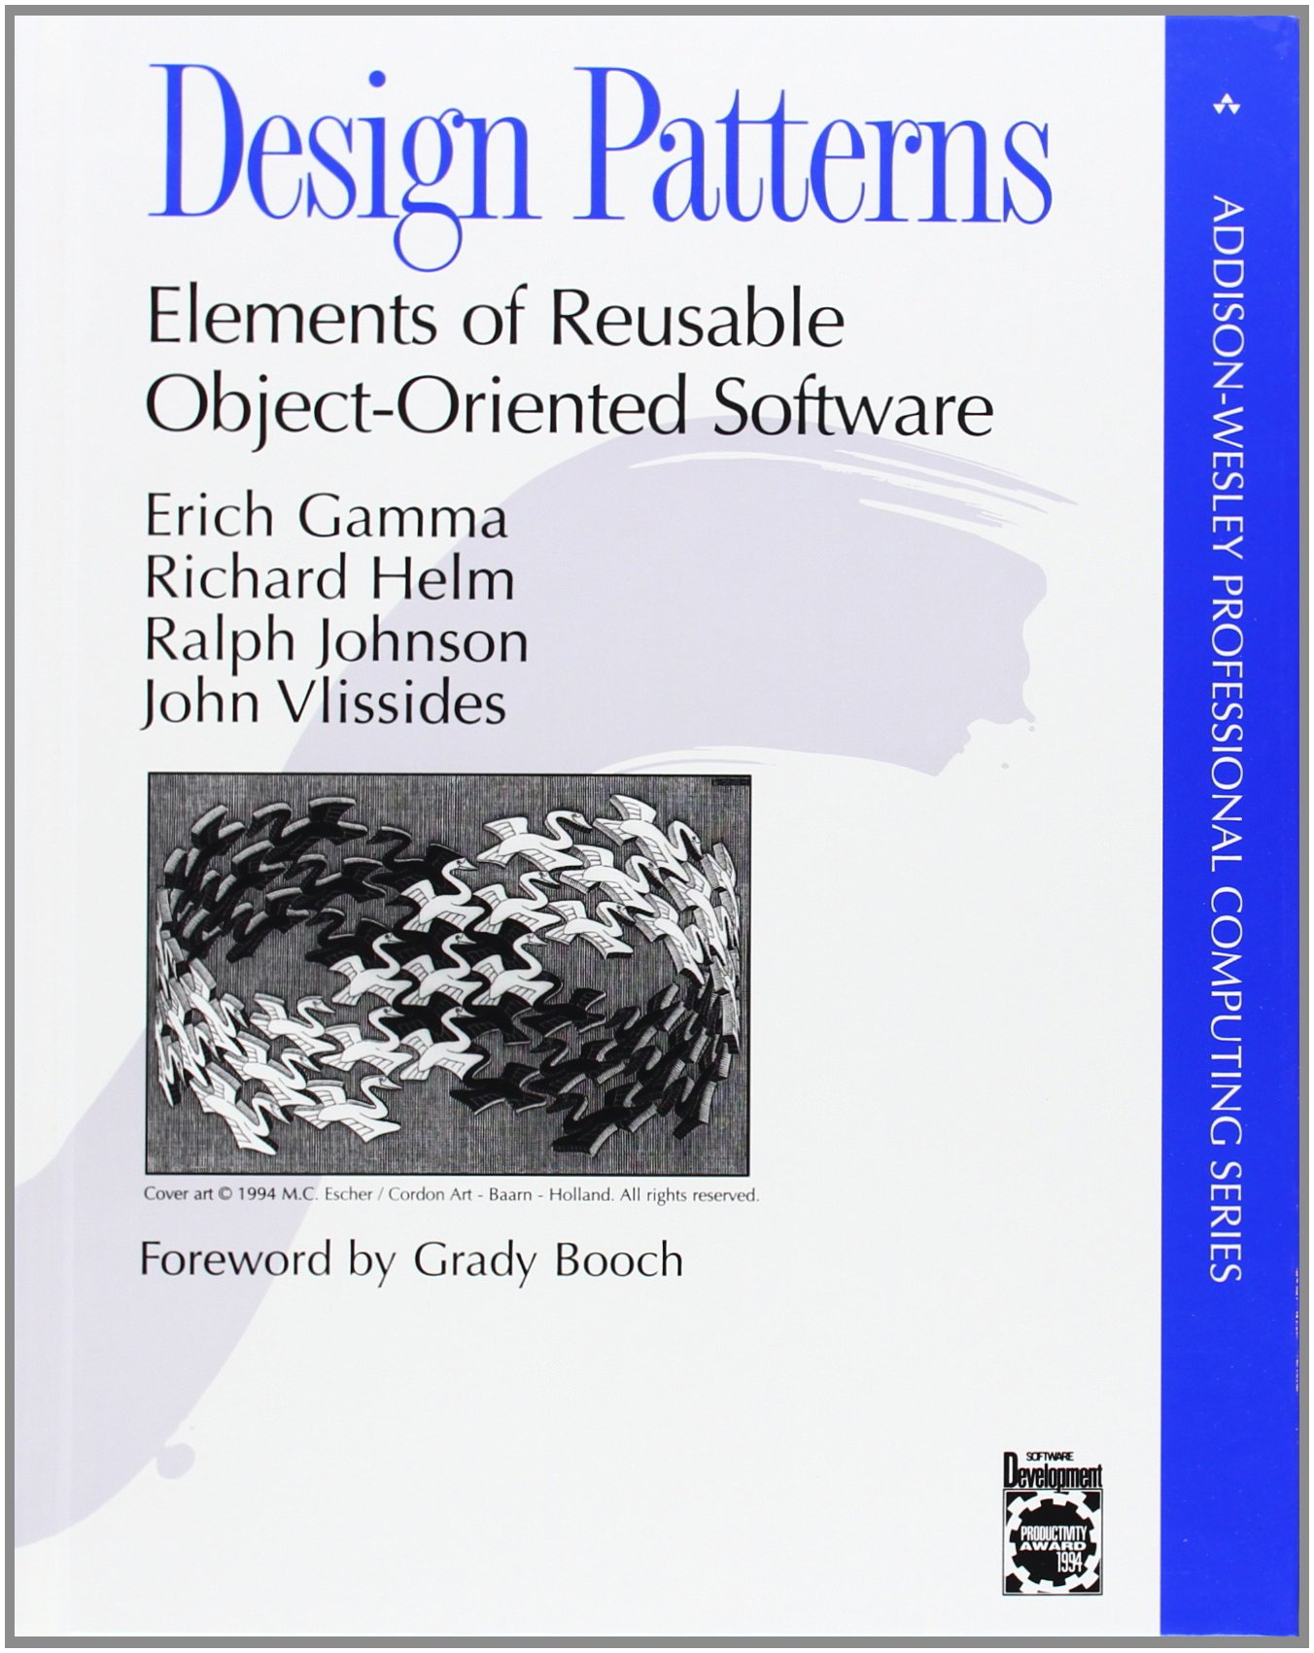
Selected Scientific Text:
Design Patterns: Elements of Reusable Object-Oriented Software,
Addisson-Wesley Publishing company, 1994
Authors (also refered as “Gang of four”):
Dr. Erich Gamma, Swiss, Ph.D Computer Science
Dr. Richard Helm, German, Ph.D Informatics
Dr. Ralph Johnson, American, Ph.D Computer Science
Dr. John Vlissides, American, Ph.D Electrical Engineerings
Page count: 354

Slide 3

Why I chose this book and why it is still relevant?
Why it is still relevant:
Patterns of object-oriented programming do not change
Not only beginner friendly, but also good for the experts
Can be used as a textbook for students

Slide 4
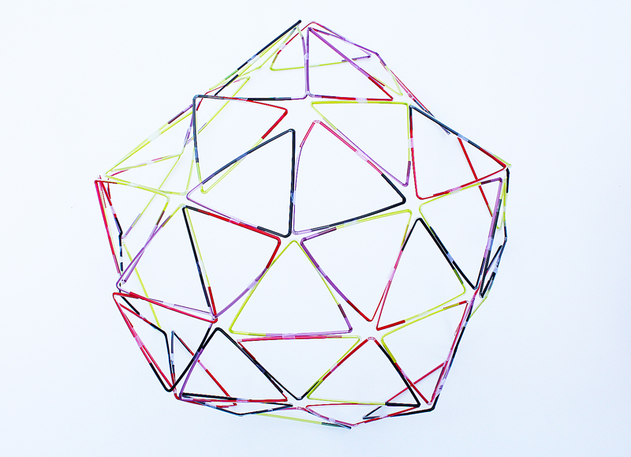
Structure of the book
Consists of 2 parts:
Chapters 1 and 2 – Definition of design pattern and their usage.
Chapters 3 to 5 – Catalog of actual design patterns (this part makes up the majority of the book).

Slide 5

Design Pattern
Elements:
Pattern name
Problem
Solution
Consequences

Slide 6

Describing design patterns
Graphic notations
Decisions
Alternatives
Trade-offs
Concrete examples

Slide 7
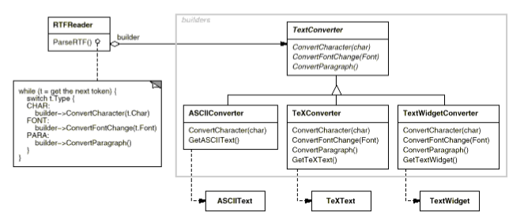
Pattern: Builder
Intent: Separate the construction of a complex object from its representation so that the same construction process can create different representations.

Slide 8
Pattern: Builder
Applicability:
Use the Builder pattern when:
the algorithm for creating a complex object should be independent of the parts that make up the object and how they're assembled.
the construction process must allow different representations for the object that's constructed.

Slide 9
Pattern: Builder
Consequences:
It lets you vary a product's internal representation (all you have to do to change the product's internal representation is define a new kind of builder).
It gives you finer control over the construction process (This gives you finer control over the construction process and consequently the internal structure of the resulting product).

Slide 10
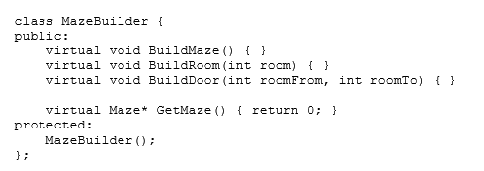
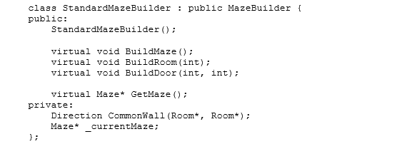
Pattern: Builder
The MazeBuilder class defines the following interface
Implementation of MazeBuilder with StandartMazeBuilder

Slide 11
Scientific Text Analysis
Presentation made by Tadas Laurinaitis IFF-6/8

Slide 12

The End

